Slide 1
Jchem applications in Medchem
Prediction and Data Sorting
Zhengtao Li/06-24-2019

Slide 2
Introduction
https://www.ppdi.com/About/About-Drug-Discovery-and-Development

Slide 3
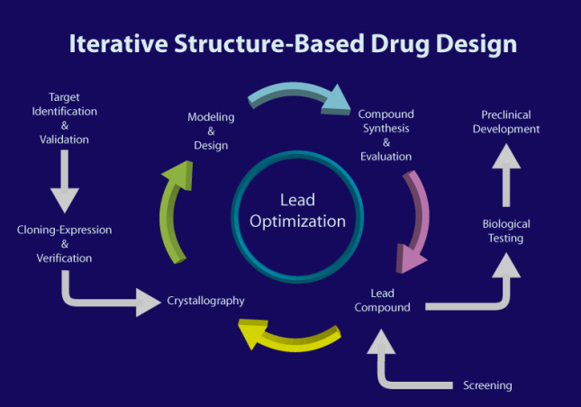
What medchem should focus?
Drug candidate, of course
IP
Target engagement
ADME property

Slide 4
Targeting EGFR/her2 exon 20 insertion mutations in non-small cell lung cancer

Slide 5
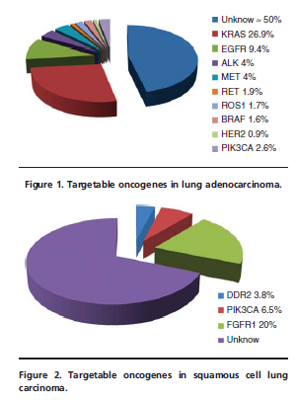
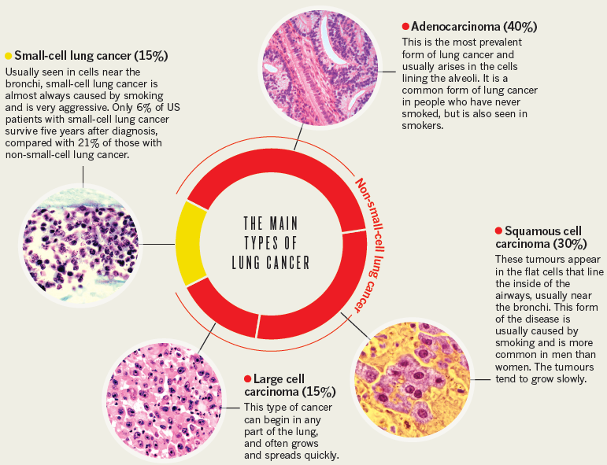
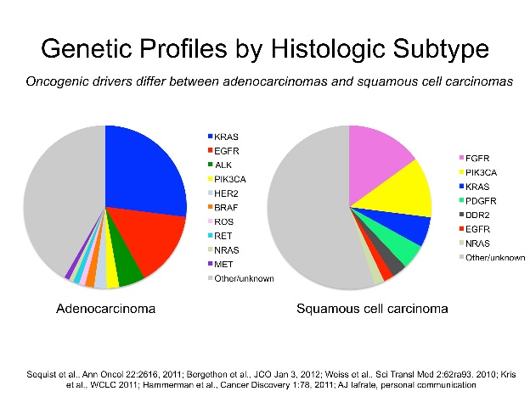
Background
腺癌
NSCLC
鳞癌

Slide 6
Prevalence of rare EGFR gene mutations in non small-cell lung cancer:
Exon20 a most common atypical mution
15-20% of EGFR mutations are “atypical”
~50% of “atypical” mutations are Exon 20
Arcila et al. Mol Cancer Ther; 12(2) February 2013
Krawczyk et al. Annals of Oncology，2015

Slide 7
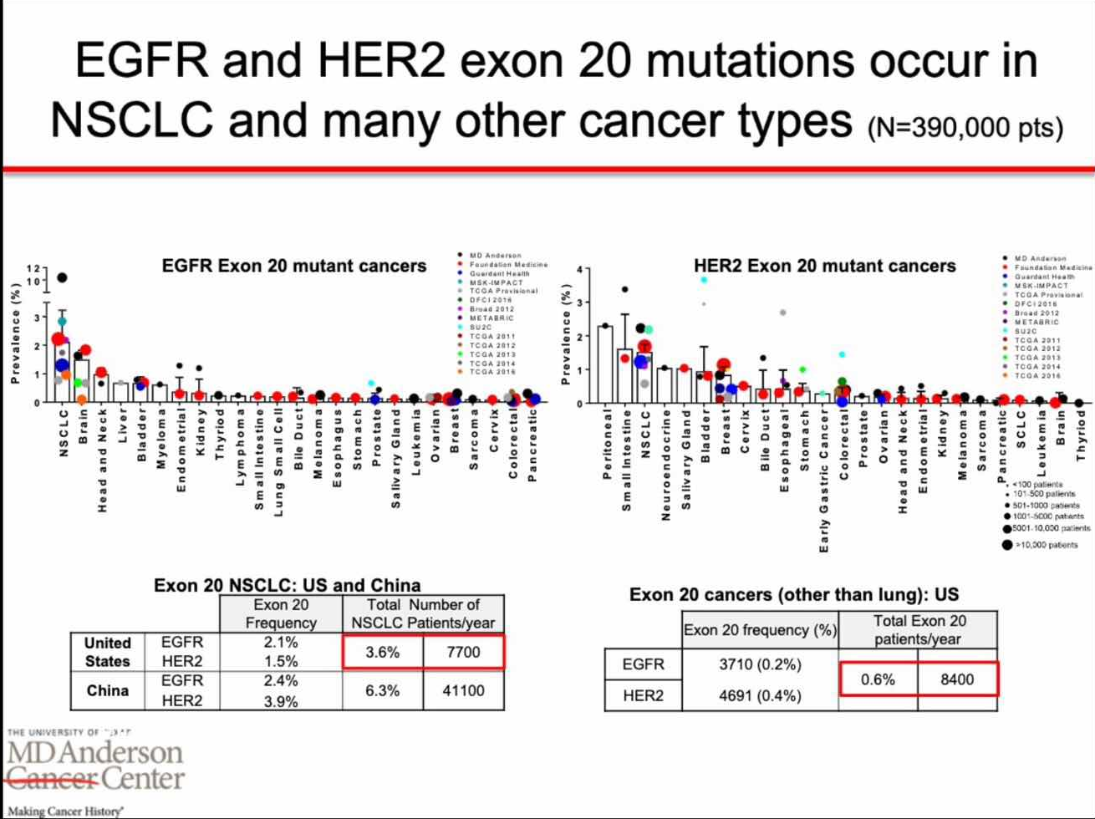
John Heymach, 2019 ASCO Education session（June 1,2019）

Slide 8
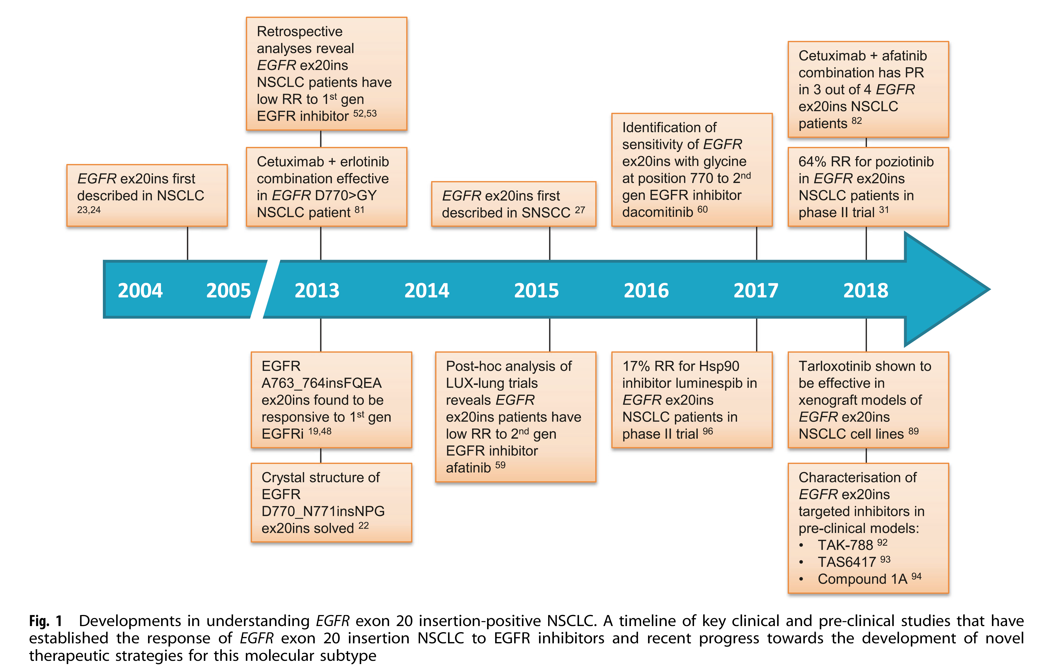
Understanding of Exon20 insertions in NSCLC
Signal Transduction and Targeted Therapy ( 2019) 4:5

Slide 9
Exon 20 insertions in tyrosine kinase domain
crystal structure of D770_N771insNPG revealed an
active conformation with the C-helix adopting an inward position.
exon 20 insertions
essentially “lock” EGFR molecules in an active conformation in the absence of ligand binding.
Mutations occur within the C-terminal end of the C-helix or more frequently in the loop that immediatelyfollows.

Slide 10
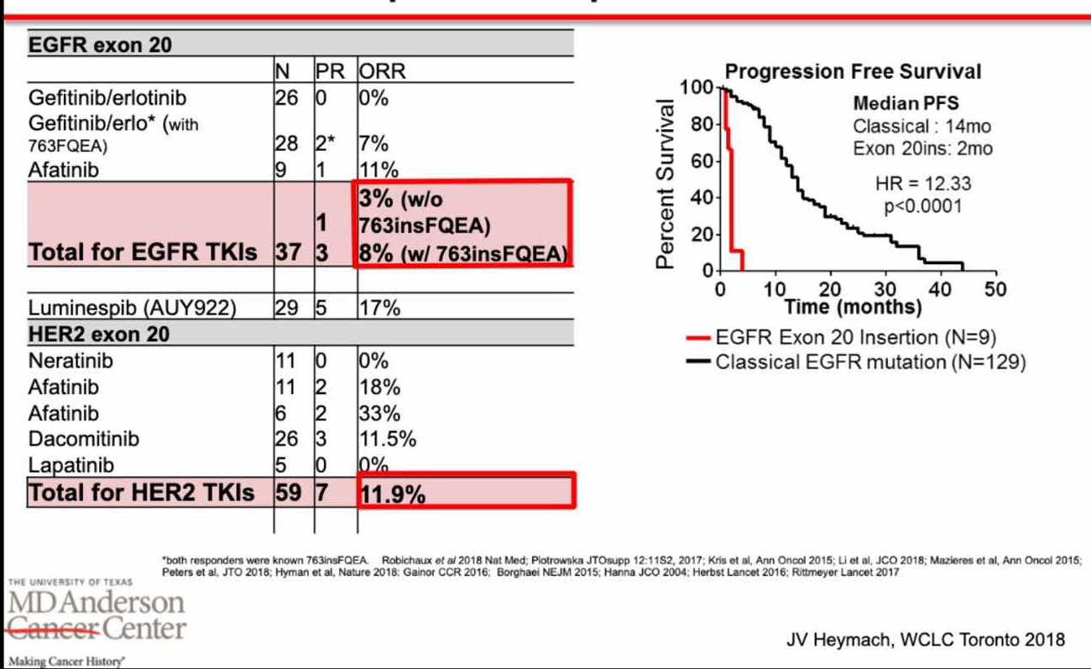
Patients with EGFR or HER2 exon 20 NSCLC have poor response to current TKIs
Kinetic study reveals that D770_N771insNPG mutation is capable of activating EGFR without markedly diminishing ATP affinity or enhancing affinity for the first-generation inhibitor gefitinib.
computational modeling of the solved D770_N771insNPG crystal structure to attribute the lack of affinity for first-generation EGFR
inhibitors to a prominent shift of the C-helix and phosphate-binding loop (p-loop) of EGFR into the drug-binding pocket, resulting in significant steric hindrance
John Heymach, 2019 ASCO Education session（June 1,2019）

Slide 11
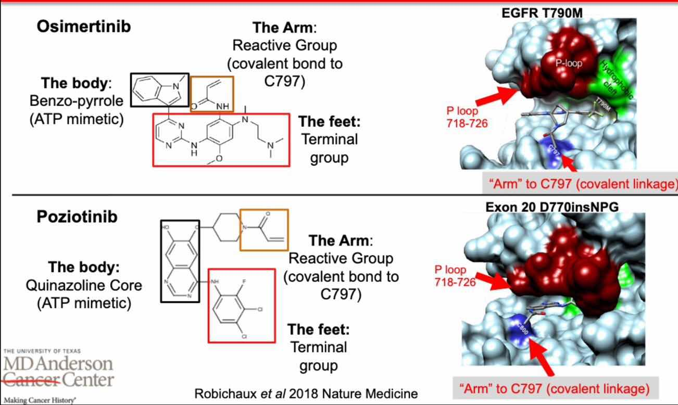
What about efficacy of 2nd or 3rd gen EGFR TKIs?
John Heymach, 2019 ASCO Education session（June 1,2019)/ Robichaux et al. Nature Medicine, 2018

Slide 12
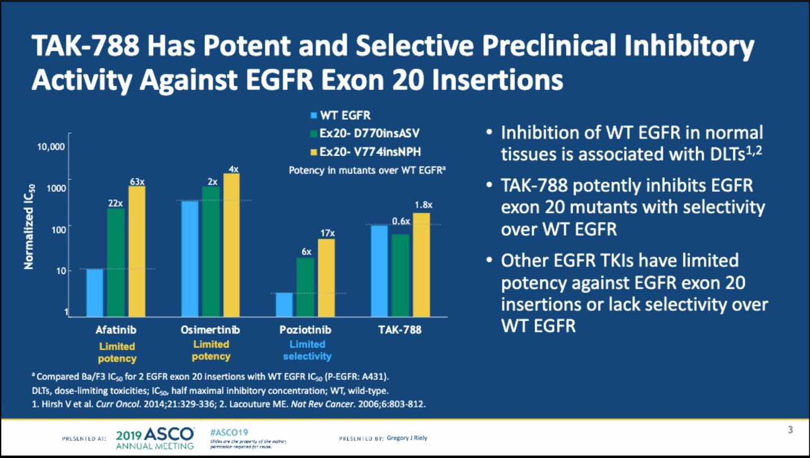
Potency VS selectivity
Pasi A Janne, 2019 ASCO poster

Slide 13
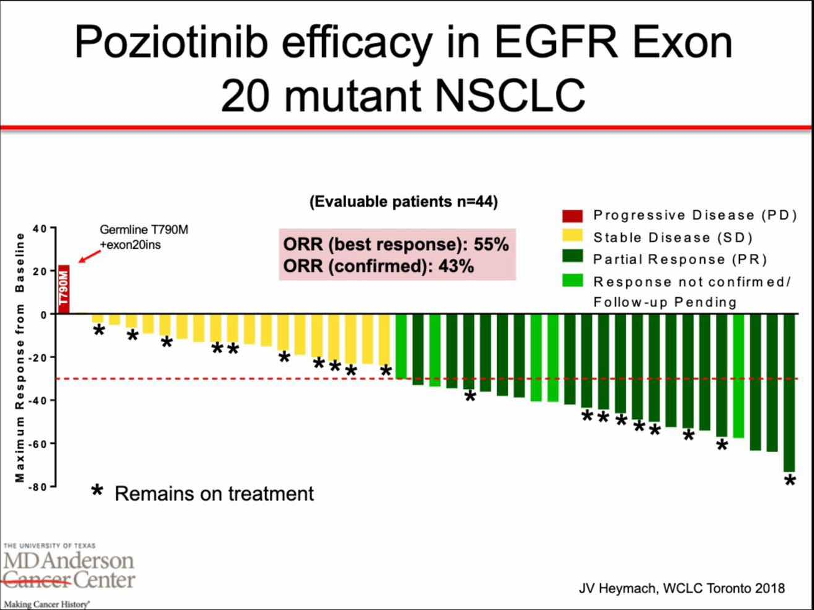
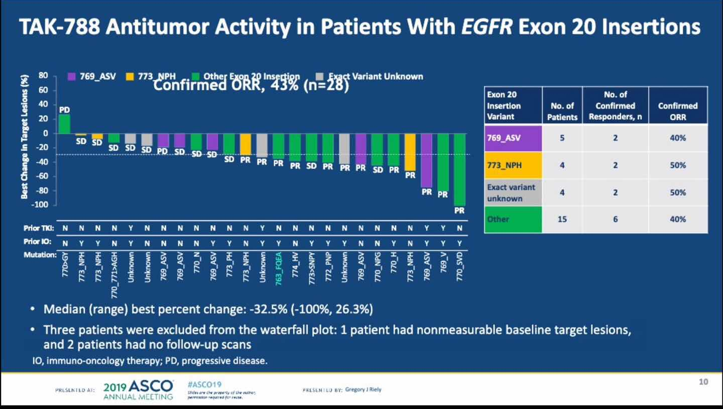
Clinical efficacy

Slide 14
Bottom line for EGFR and HER2 exon 20 mutant NSCLC
TKIs including poziotinib, TAK788, Tarloxotinib, pyrotinib, DZD9008 and others in development
ADCs(DS-8201a) and JNJ-372(EGFR-MET bispecific antibody)
But therapeutic window is still narrow to achieve high ORR, mPFS still shorter than classical mutants
Better drug is always better
DZD9008, an oral, wild type selective EGFR inhibitor for the treatment of non-small-cell lung cancer with Exon20 insertion and other activating mutations
110th Annu Meet Am Assoc Cancer Res (AACR) (March 29-April 3, Atlanta) 2019, Abst 3081

Slide 15
Rationale design
Synthesis
Target engagement
evaluation
ADME
evaluation
Design
Synthesis
Target engagement
evaluation
ADME
evaluation
Design
What Jchem
can do?
SAR
understanding
SAR
understanding

Slide 16
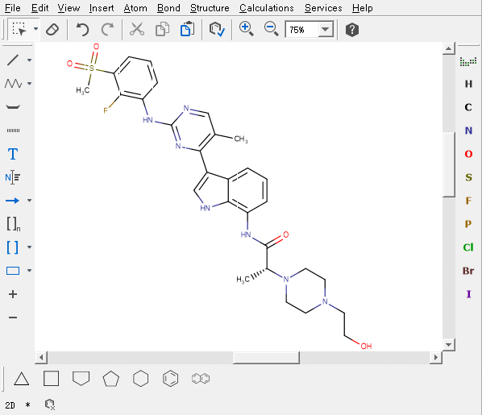

Jchem functions
calculations
Structure analysis
Structures exported from WO2018134213

Slide 17
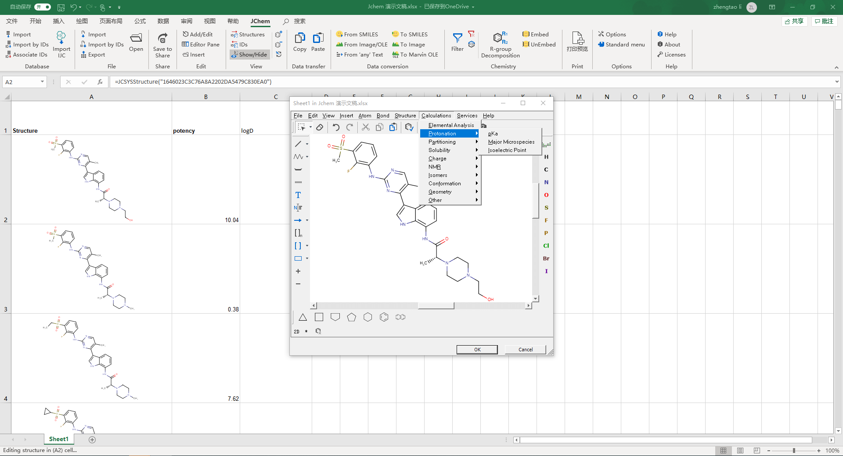
Physicochemical property prediction

Slide 18
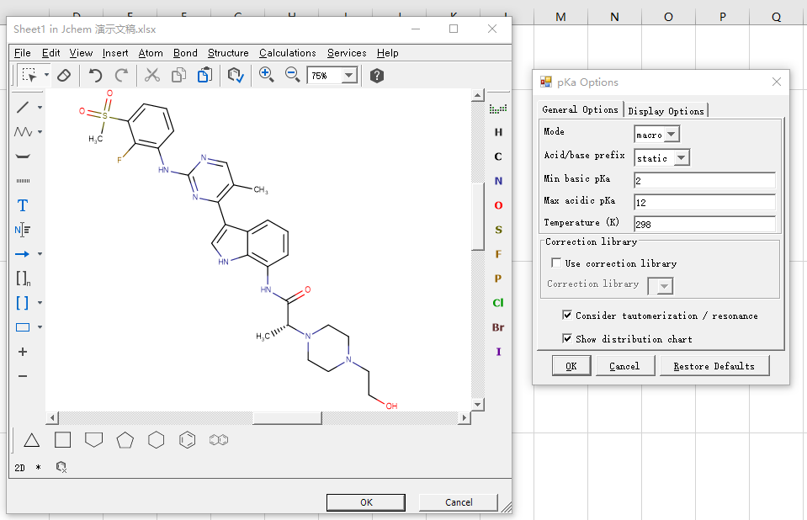
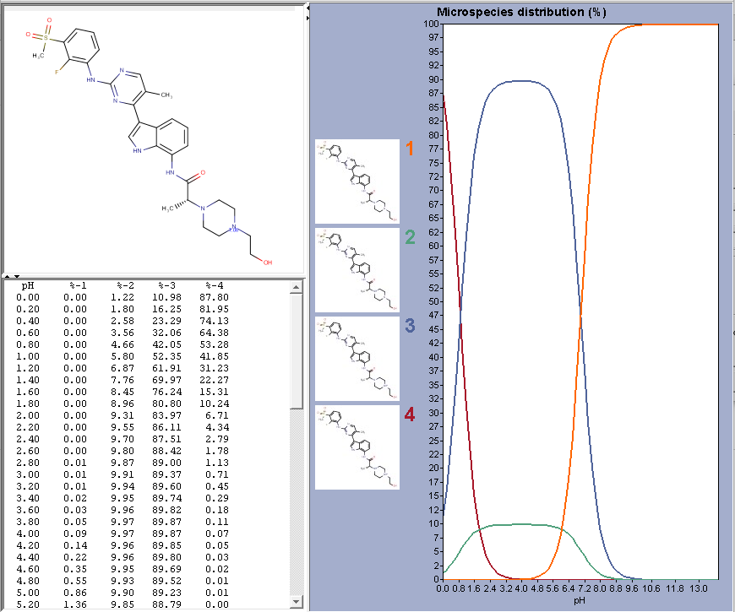
pKa

Slide 19
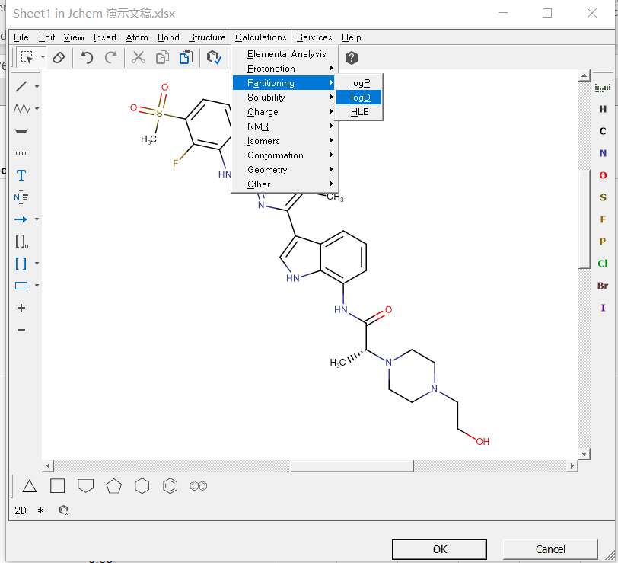
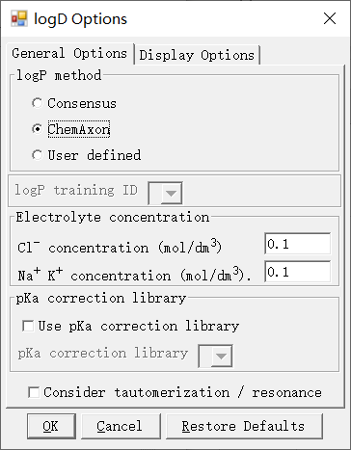
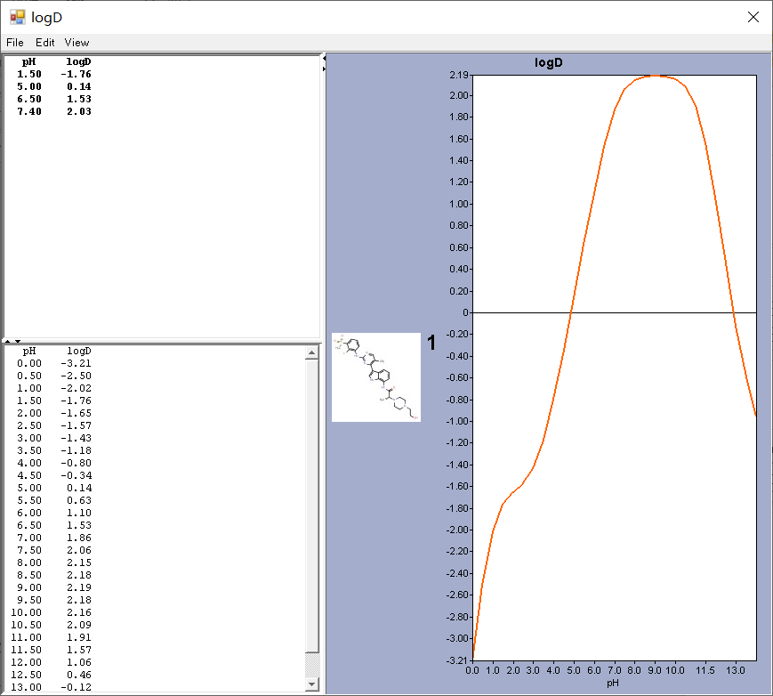
Log D

Slide 20
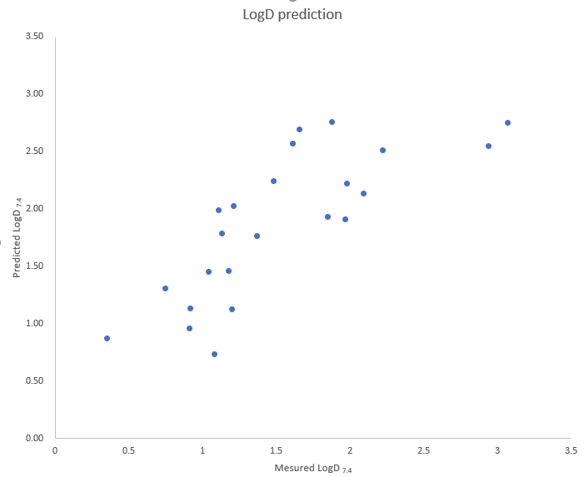
Measured vs predicted LogD

Slide 21
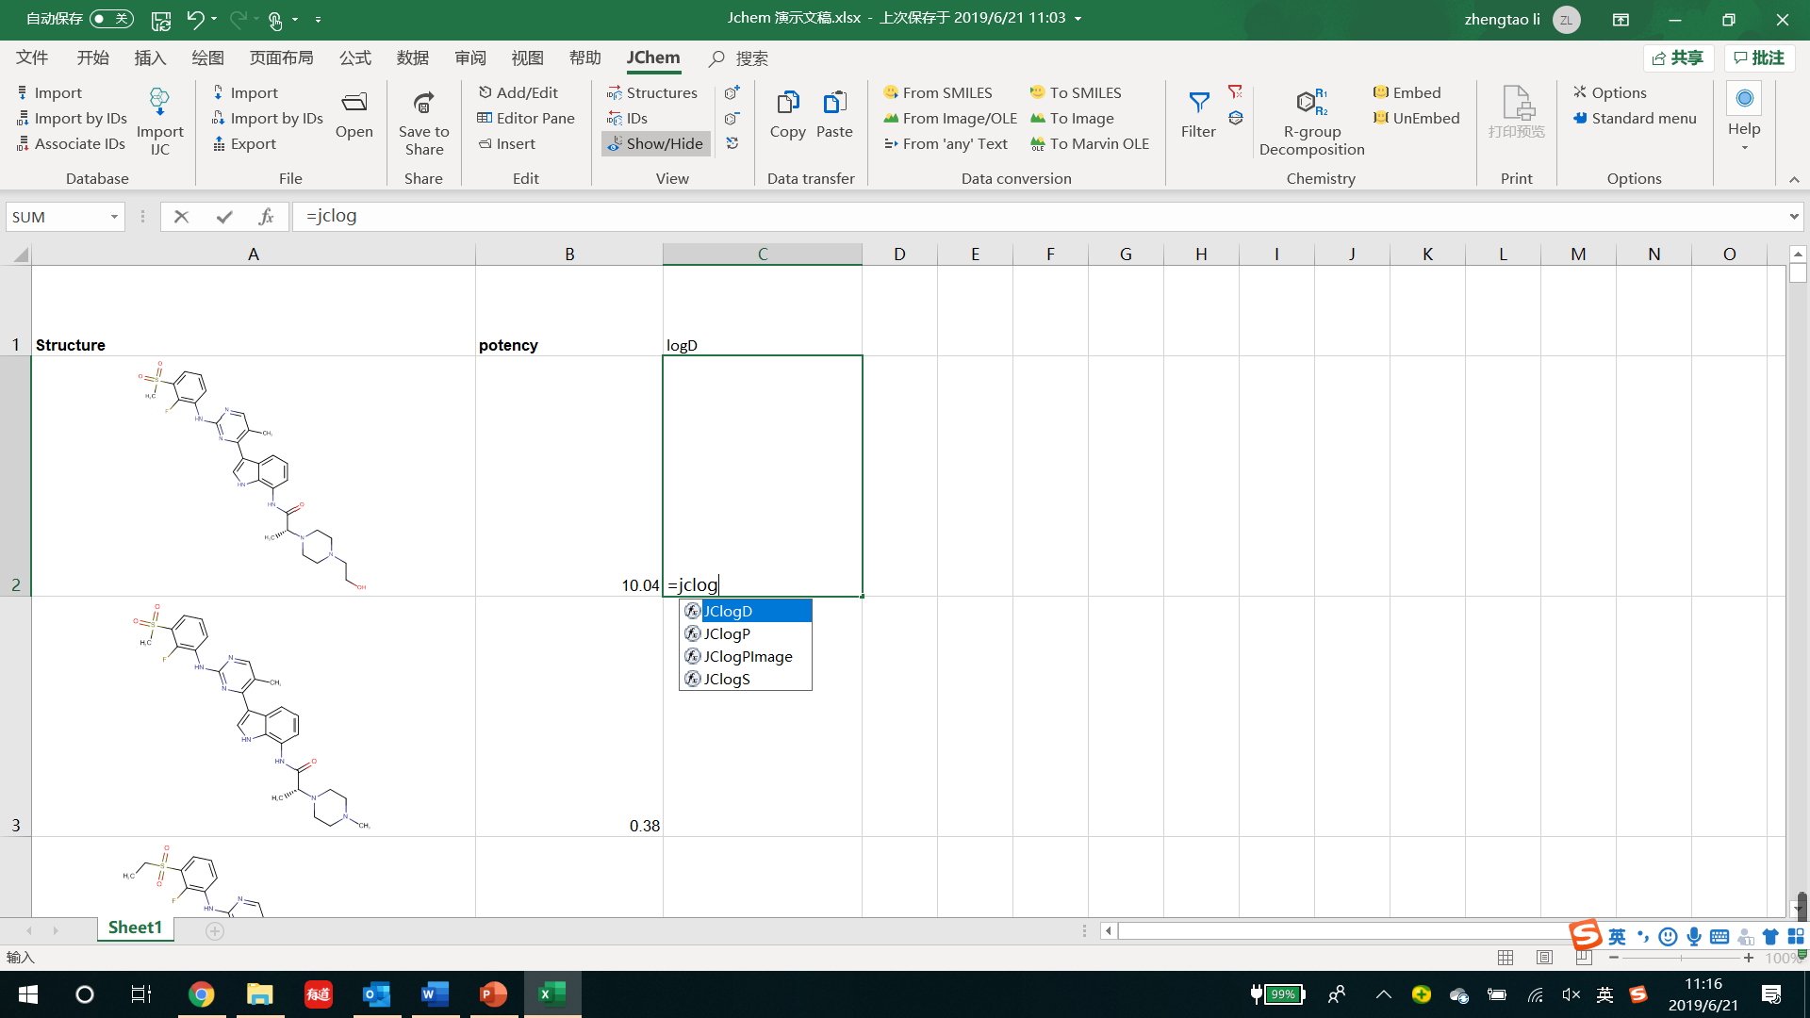
Jchem excel formula fx（=JCxxx）
Over two hundred functions
Easily pull out a series of predictions

Slide 22
Jchem functions
calculations
Structure analysis

Slide 23
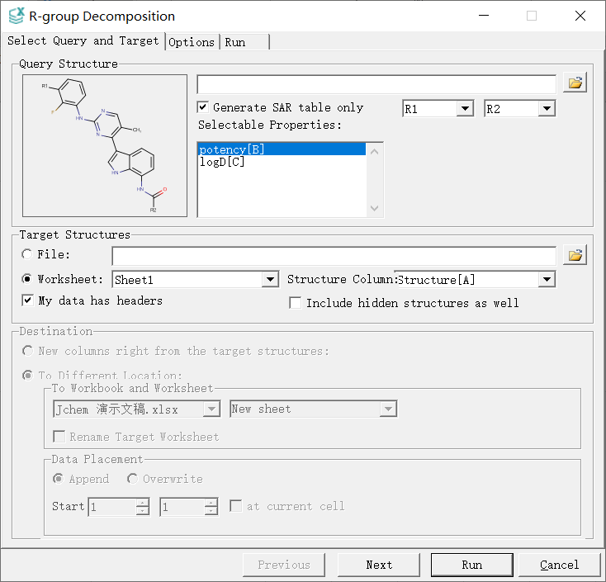
SAR table generation
Not limited to potency

Slide 24
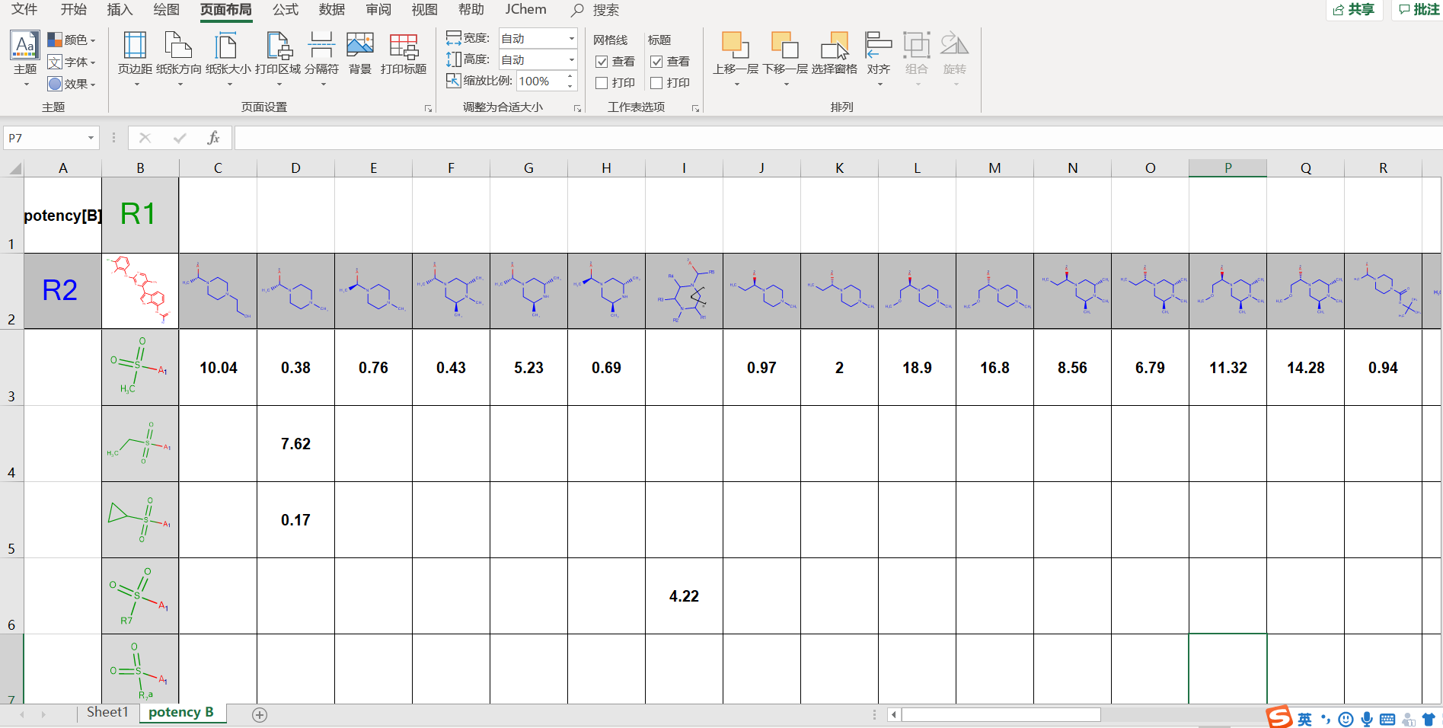
SAR table generation

Slide 25
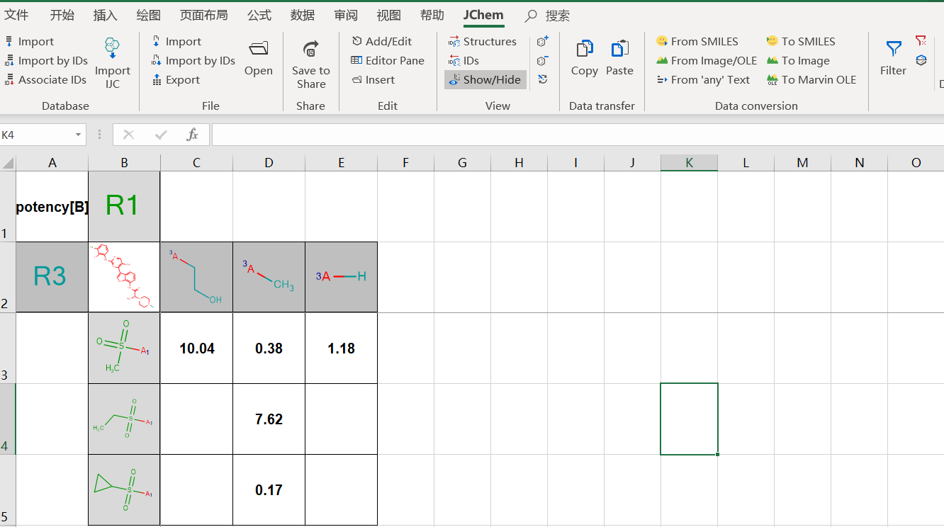
SAR table generation

Slide 26
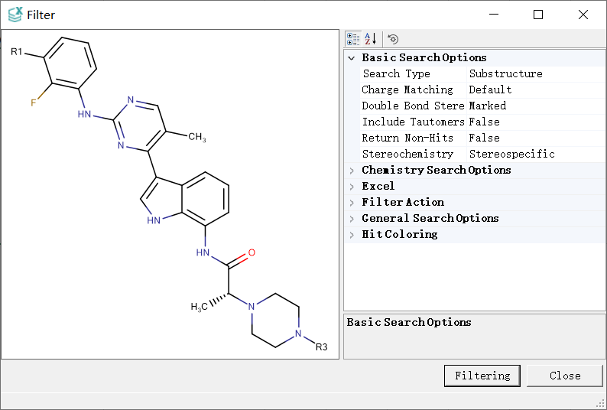

Structure filter

Slide 27
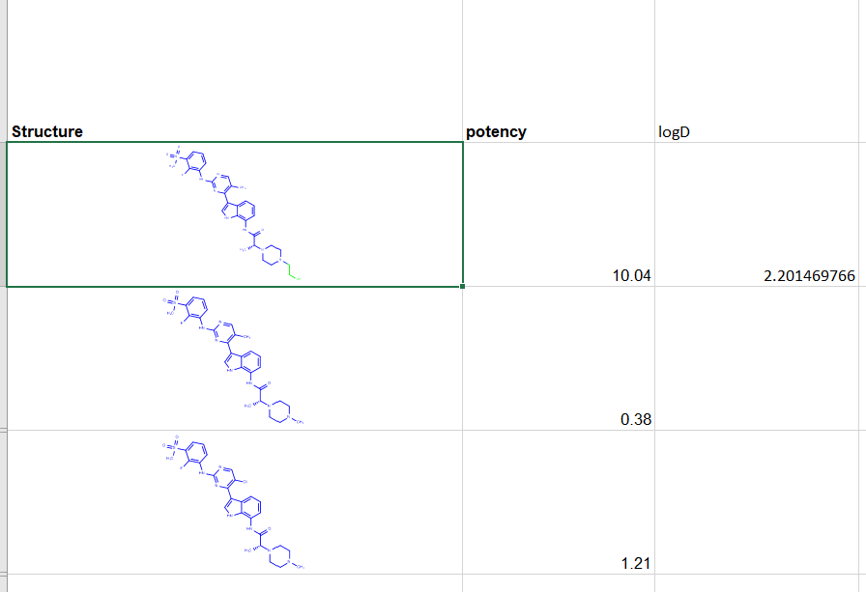
Structure filter

Slide 28

What we expect next for Jchem?
Local database version
Less bug
No need to be customized
More reliable performance
Attractive price
More prediction tools
Price sensitive users
Caco-2, CYP DDI, hERG… ACD lab functions？

Slide 29
Thanks

